Slide 2
PEPFAR
The U.S. President’s Emergency Plan for AIDS Relief (PEPFAR) is the largest source of funding for the HIV response globally, including screening, diagnosis and treatment of AIDS/Advanced HIV Disease.
Most funding is focused in Sub-Saharan Africa, Haiti, and in smaller regional programmes in Asia, the Caribbean, and Latin America.

Slide 3
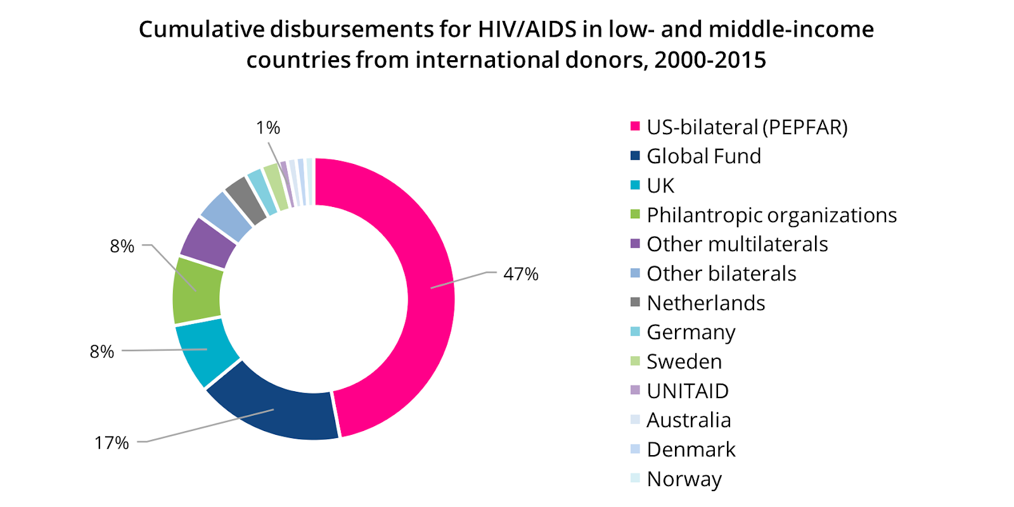
Why focus on PEPFAR?

Slide 4
PEPFAR
PEPFAR serves as the umbrella and coordinator for all U.S. government agencies providing funding for the AIDS response.
1. The U.S. Centers for Disease Control (CDC)
2. USAID
3. Department of Defense (DoD)
These agencies are the ones that write the contracts and manage the programmes — so HIV programmes funded by CDC or USAID or DoD are part of PEPFAR.

Slide 5
Who gets PEPFAR funding?
PEPFAR funding goes to ‘implementing partners’ (IP) that are most often large, non-governmental organisations (NGOs).
Implementing partners are then responsible for running HIV programmes and sometimes provide funding to other organisations as sub-contractors (“subs”) including smaller, local organisations to implement programmes.

Slide 6
The Country Operational Plan
The Country Operational Plan (COP) is an annual plan created jointly by USAID and CDC that outlines how the billions of dollars in HIV funding from the U.S. government will be spent.
What is in the COP?
— The goals and priorities for the country
— What strategies and interventions will be used by the IPs
— “Where” and “who” will be prioritised
— The targets
— A detailed budget

Slide 7
How do we influence the COP?
For years the COP process was closed—a confidential U.S.-government-only set of discussions that excluded affected communities.
Health GAP and a coalition of activists in the U.S. and in PEPFAR implementing countries fought to open the process, beginning in 2013. We continue to insist that the inputs from people most affected by HIV should weigh more heavily than those from bureaucrats.
Currently, members of civil society are able to take part in COP planning and monitoring in most countries through quarterly “POART meetings”.

Slide 8
How do we influence the COP?
But a seat at the table does not necessarily translate into meaningful input into PEPFAR programme planning.
Only where activists have proactively used these opportunities to hold PEPFAR accountable — pushing the programme to deliver on the transparency and access it has promised — has ‘engagement’ resulted in impact.

Slide 9
What have activists “won”?
In Tanzania, a significant increase in the countries PrEP Targets to 100,000
In Kenya, scale up of support for key population-led organisations to provide service delivery to increase testing and retention and an increase in the number of comprehensive care clinics for key populations to $20.5 million
Community monitoring expanded to all PEPFAR countries to empower community of people living with HIV, ey populations, civil society organisations to monitor the quality of service delivery.
Notes:
Not only this!!
These are just a couple of examples.

Slide 10
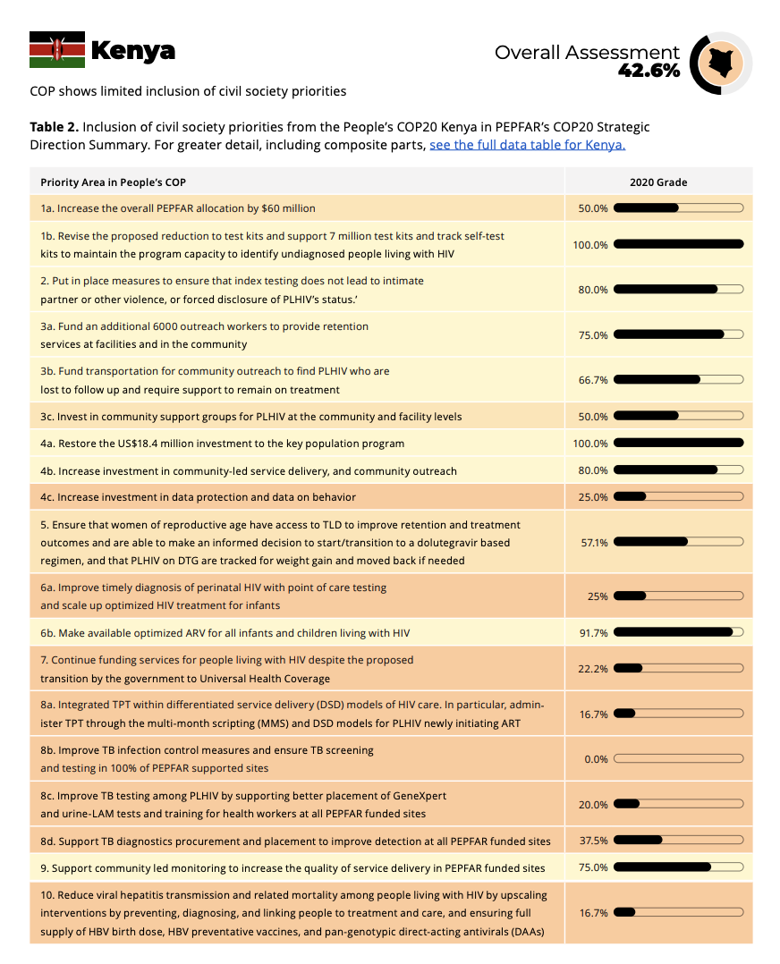
What’s New in our advocacy
We will release 2021-22 edition of “Measuring Up,” a side-by-side analysis of what activists demanded from PEPFAR vs. what they won in the final PEPFAR COP21, for use in COP22 advocacy
PEPFAR Watch advocacy tools (including the updated Rough Guide, etc) on pepfarwatch.org
COVID-19 updates: how to have activist impact in virtual COP planning spaces
PEPFAR: new categories for countries; new emphasis on key populations

Slide 12
The COP Calendar for Activists

Slide 13
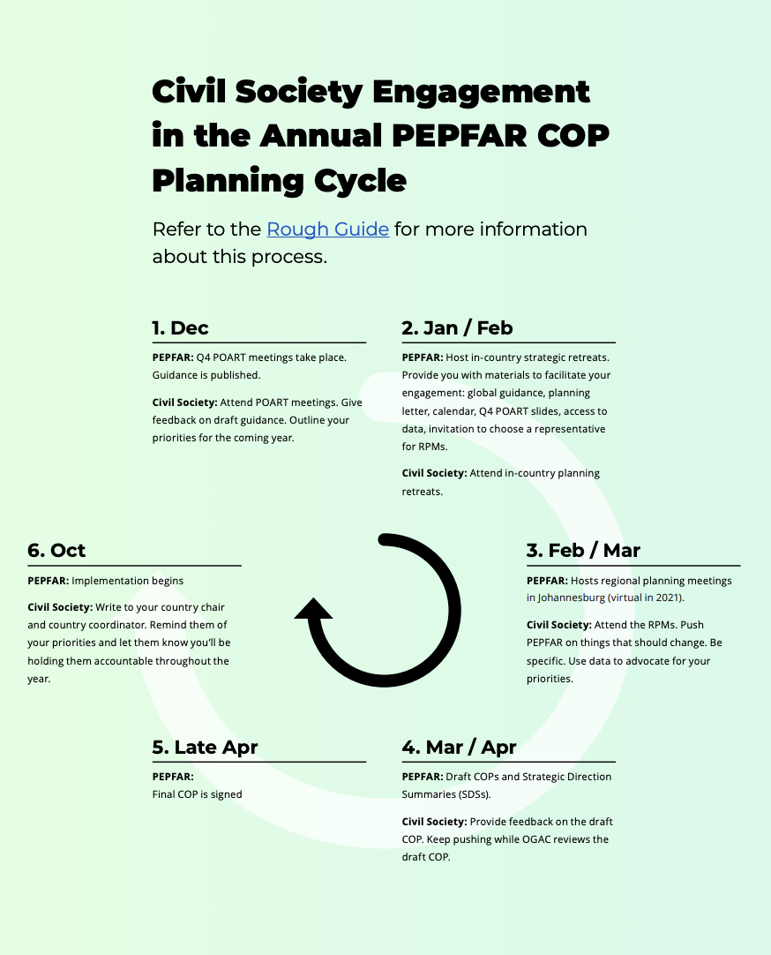

Slide 14
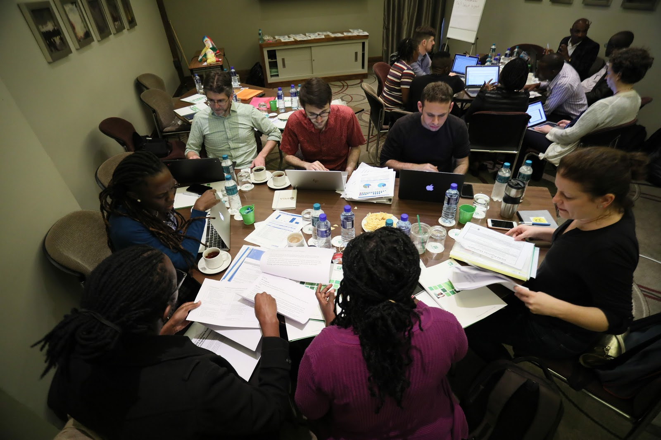
COP Activist Calendar
When? | What happens? | What can activists do?
December 2021 | Country Operational Planning (COP) advocacy calendar starts now. Start building a list of priorities for what civil society organizations suggest PEPFAR should fund differently in 2022 than in 2021. | 1.. SDSs are up on the PEPFAR Website … download it and have a meeting to go through and see what made it in there. What are you concerned about. If you are not the list please email info@healthgap.org and we will send you the link 2. Start meeting to review last year’s COP and begin building a list of recommendations and demands you can submit to PEPFAR by the end of January 2022. (https://www.pepfar.gov/countries/cop/index.htm) 3. Take a look at the PEPFAR data for 2021 as a tool for advocacy—it tells an important story of what is working and what is not. All PEPFAR data is now online! pepfarwatch.org/resources 4. Start identifying who your strongest advocates are to attend the PEPFAR COP virtual reviews. 5. Get in touch with your PEPFAR coordinator to ask them for a calendar of important meetings and deadlines for your country.

Slide 15
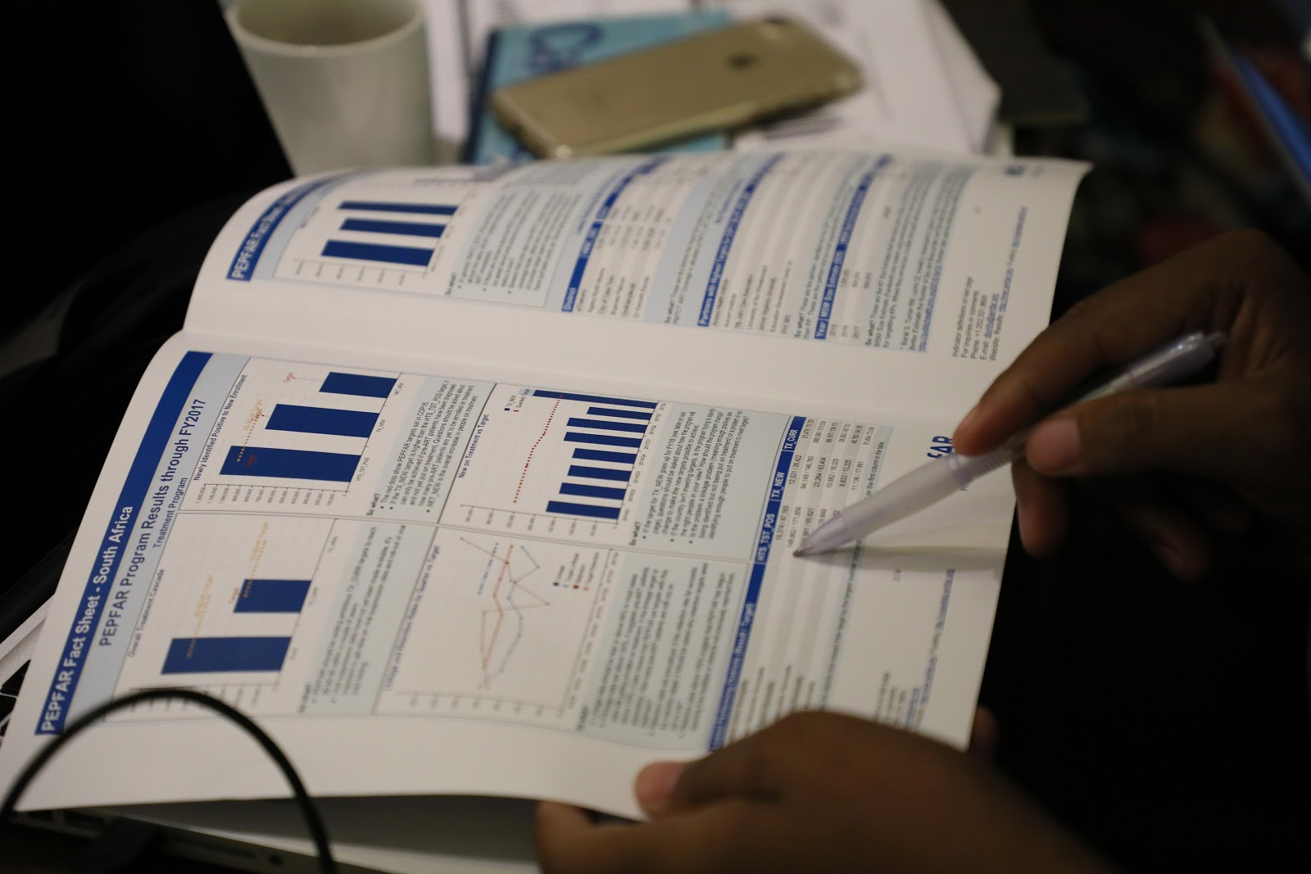
When? | What happens? | What can activists do?
January 2022 | The formal PEPFAR process begins—This is the time to identify your priorities for change. | 1. Build a written priority list so you send it along with your representative to the strategic retreat at the end of January. We’ve provided a template you can use to do this, below. 2. Ask the PEPFAR coordinator for the materials you need to be engaged. They should provide: • A calendar for the next few months • Quarter 4 POART slides • Access to the data (but you don’t have to wait, see above) • Initial invitation for community to choose a representative to be invited for the Regional Management Review • Solutions Platform, previous SDS, SIMS outcomes Need to analyze the data and materials – what was good/bad?

Slide 16
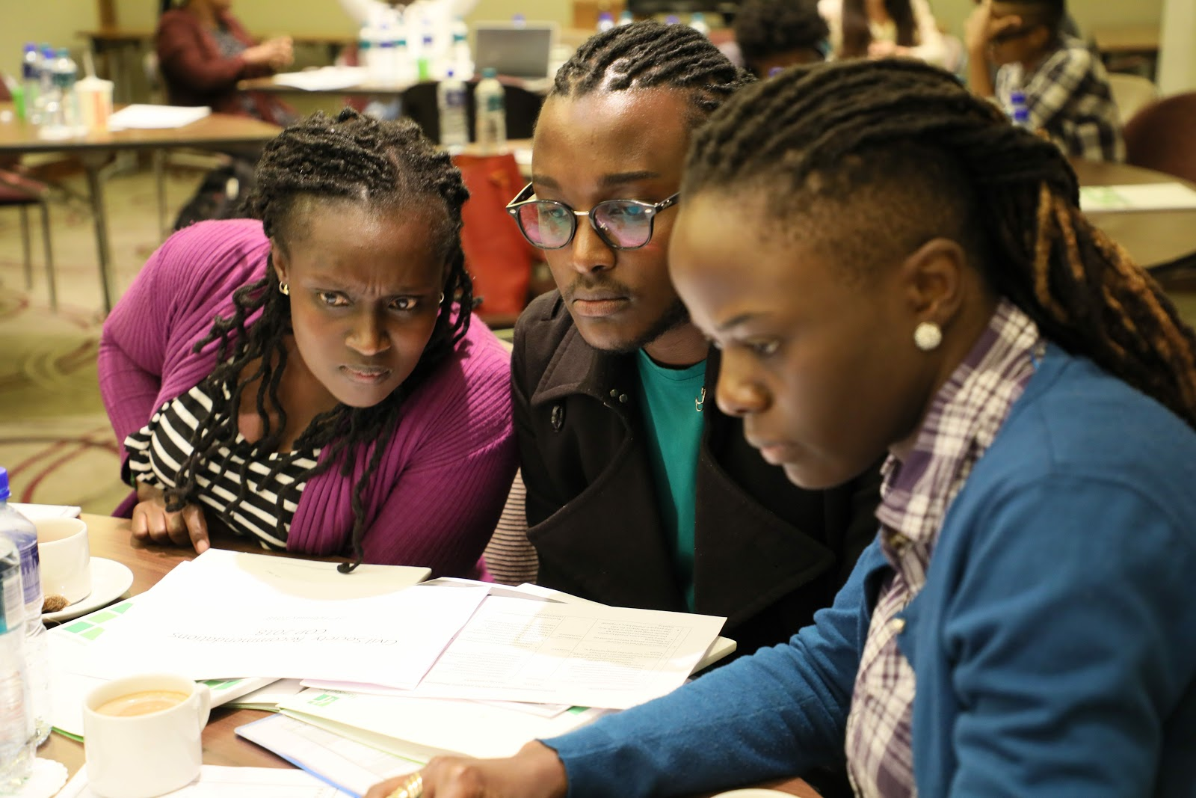
When? | What happens? | What can activists do?
January - early Feb 2022 | PEPFAR teams in each country have a “strategic retreat.” Retreats to be held no later than week of Feb 7 2022. | In person meeting for analysis of the docs shared in last slide and Q4 data and focus on solutions that will form basis of COP22 – they will share other data and results. 1. Contact your PEPFAR Country team and ask to be invited. 2. Come with a clear set of initial demands/priorities. 3. Start work on a formal submission from your groups about what you want to see in PEPFAR’s 2022 plan for your country 4. Ask for Quarter 4 results & POART slides.

Slide 17
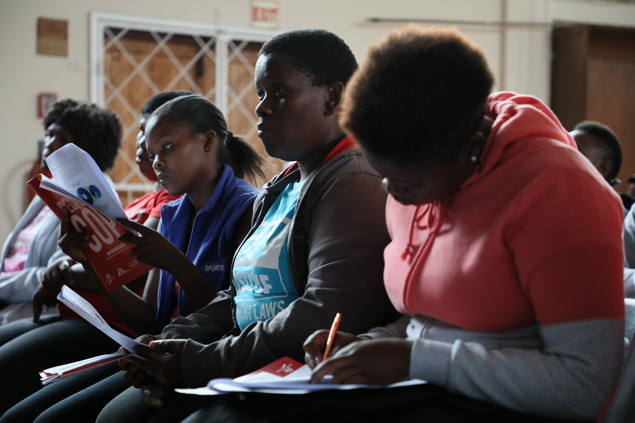
When? | What happens? | What can activists do?
January / February 2022 | Preparation for in-person planning meetings. (Prior to the COP22 Meetings, teams will submit to headquarters for review the Datapack (targets); FAST (budgets); Table 6 (non-service delivery activities); and Surveillance, Research, and Evaluation (SRE) inventory. Headquarters teams will review these tools and provide feedback to teams so that teams can make relevant adjustments prior to the COP22 meetings.) | COP guidance and Planning Level Letters released January 19 2022. Prepare a written submission regarding what you think should change and send it to them as soon as you can. To do this: • Consult with communities, especially those outside capitals, get their input and their evidence about why changes are needed. • Use data from PEPFAR, gather other evidence, stories, and experiences. • Be specific about what should change from last year’s Country Operational Plan. What should be added? Who should be covered? Where? • Make sure to share your priorities with global civil society networks who can make sure staff in PEPFAR headquarters in Washington are aware. • Rolling submission and review of tools (Datapack, FAST, Table 6 Excel Workbook and SRE Tool) Group 1 - TBD Group 2 - TBD Group 3 - TBD

Slide 18
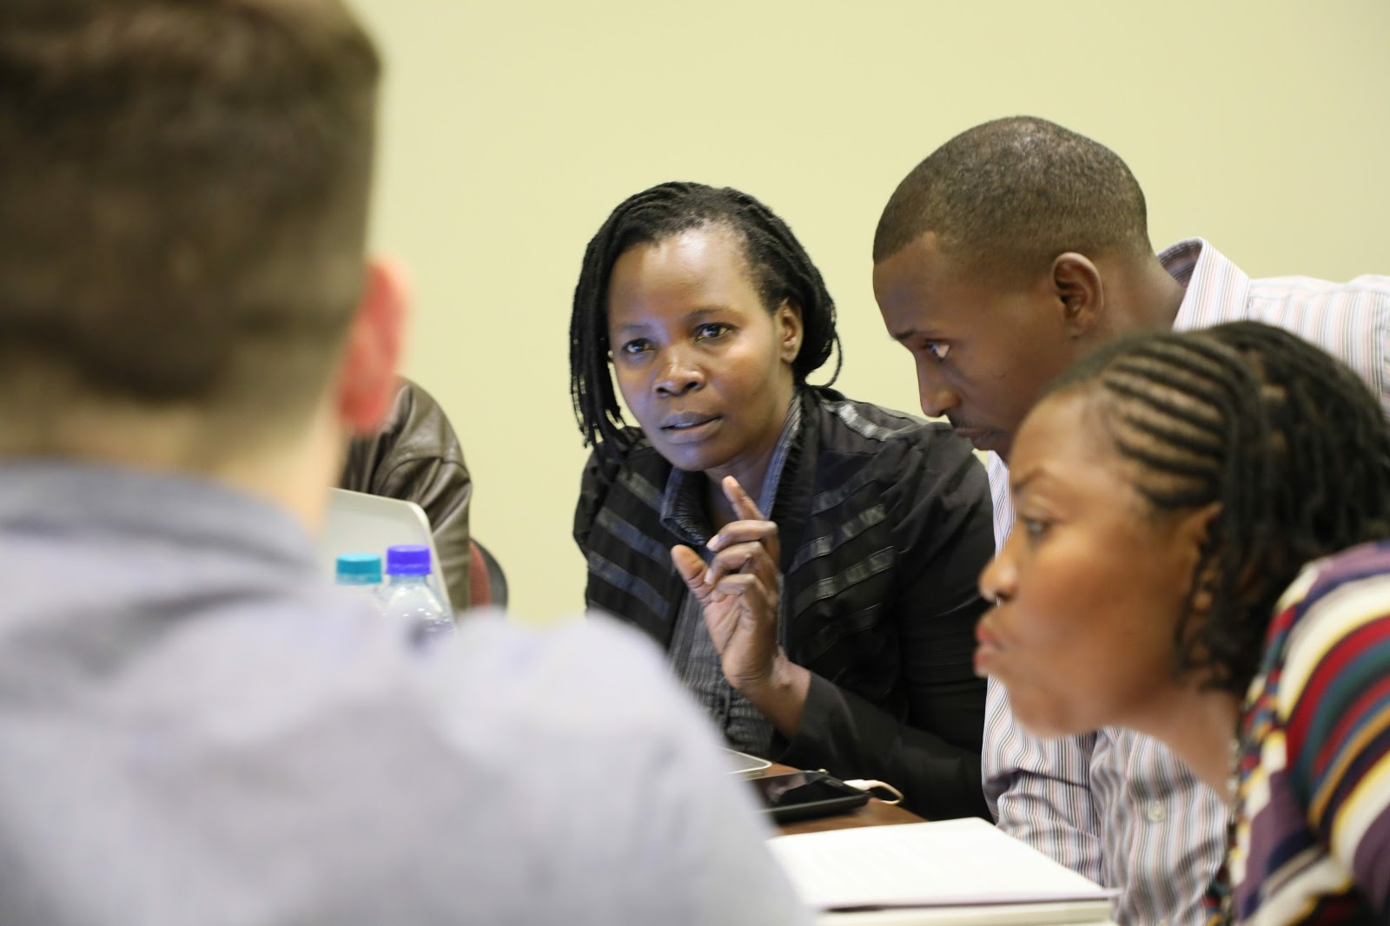
When? | What happens? | What can activists do?
Week of March 7 (Group 1) Week of March 14 (Group 2) Week of March 22 (Group 3) If country is at ‘epidemic control’ then week of March 14 or 22 | 2022 COP Virtual Planning Meetings: PEPFAR country & Washington D.C. teams, local and international civil society groups, representatives from recipient country governments, UNAIDS and Global Fund gather virtually for meetings where they will lay out the priorities. This is a key advocacy moment where civil society can influence what PEPFAR funds. | Send your best, boldest advocates well prepared to push for your priorities. Ask the PEPFAR team to send you the data and presentations for the planning meetings at least a week in advance. Have a pre-meeting with all civil society organizations to make sure your representatives are well prepared to represent all of your priorities. Consider also doing a pre-meeting with government and implementers to gather information. Before the planning meetings make sure PEPFAR knows your major priorities, ask that they be included in the agenda for the meeting. Consider inviting the PEPFAR team to a meeting hosted by civil society to discuss priorities. Get in touch with global civil society groups who can support you at the reviews. Email us to find out who is going from the international civil society community.
The country clusters are still yet to be determined!

Slide 19
When? | What happens? | What can activists do?
March 2022 | Country Operational Plan is drafted | What was decided in the virtual in March is only the first step and many details still have to be worked out including the exact activities, budgets, and areas of geographic focus. 1. Stay in touch with PEPFAR country teams, keep pushing for community priorities as they write the COP. 2. Ask your PEPFAR country team for written feedback on the recommendations you have submitted. 3. Make it clear you want to review the narrative of the COP (known as the Strategic Direction Summary) as soon as a draft is ready.
April 19, 2022 (Group 1) April 22, 2022 (Group 2) April 29, 2022 (Group 3) At ‘epidemic control’ then April 22 or 29 | COPs due to the Office of the Global AIDS Coordinator (PEPFAR’s Headquarters) in Washington, D.C. | After COP submission, the work is not over. You can still influence by: • Lobbying the PEPFAR team to make changes before the COP approval. • Coordinating with U.S.-based and global advocates to make sure PEPFAR Washington knows about further changes you still want. Remember OGAC is now reviewing the COP and changes may still be made.
April 25 – May 13, 2022 (all groups) | COP approval | The Ambassador will officially decide whether to sign and approve the COP or not

Slide 20
How to win

Slide 21
1. Clearly outline key recommendations & demands
What is the priority intervention? Identify the area or intervention of concern (e.g. Pediatric HIV treatment, or Prevention for men who have sex with men) – focus on a short, strategic list.
What is PEPFAR doing on this currently? Take a look at the 2021 COP and our “Measuring Up” 2020-2021 report for the current language on what they’re doing. Dive into the Q3 and Q4 data — what does it tell us about progress, and why we need our interventions?
What should PEPFAR be doing on this in 2022? What specific language should PEPFAR include in the COP? What should the target be? Be clear and specific! Do we know what budget is needed?
Notes:
It is important to work with other activists ahead of the COP planning process cycle to develop a priority list of recommendations to demand from PEPFAR. This will be the basis of what you demand from the PEPFAR teams throughout the COP cycle.
By getting this clear from the beginning, you can all sing from the same sheet of music (so to speak) throughout the process—and international civil society partners (such as Health GAP) can help to amplify your demands. You can use this template to craft your demands

Slide 22
2. Dive into the PEPFAR data
By using PEPFAR’s own data and evidence to formulate demands we can make them sharper, and our proposals more specific.
Maybe there should be more focus on underperforming geographic areas?
Maybe the data proves that we need better interventions to support linkage or retention?
Maybe the data shows that programs targeting key populations need strengthening?
Whatever the demand, using PEPFAR’s own data will help strengthen our advocacy…

Slide 23
3. Community-led data collection at PEPFAR sites
As communities, we can generate our own data through community-led monitoring at some PEPFAR sites. Community-led monitoring helps us to have first hand information at our fingertips when engaging with PEPFAR in order to:
Call out PEPFAR’s poor performance; or
Prove why PEPFAR must prioritise our interventions
We can design simple monitoring surveys to systematically collect data in a handful, or more expansive, set of health facilities.

Slide 24
Community-led monitoring example:
South Africa

Slide 25
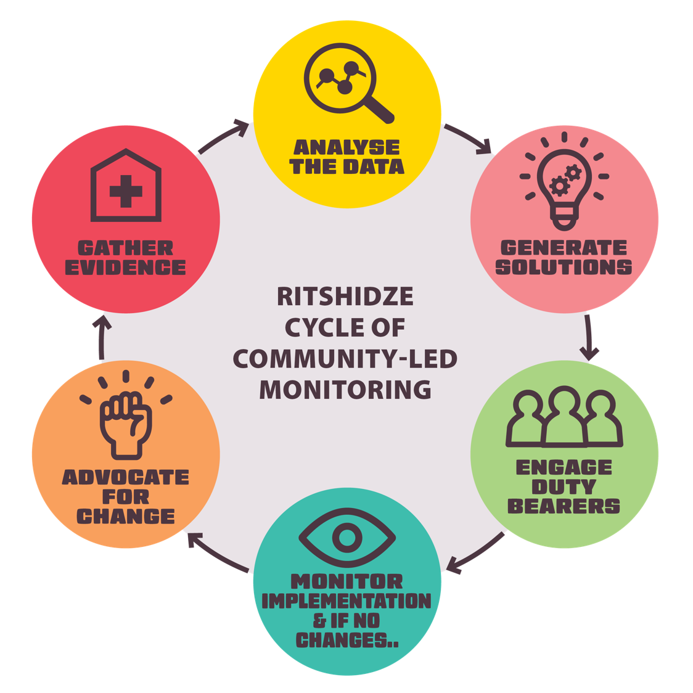
What is community-led monitoring?
+ Community-led monitoring highlights challenges where HIV and TB services are actually delivered — at public clinics
+ Monitoring of health services is routine, ongoing, and led by communities.
+ Evidence gathered from community-led monitoring leads to demand for corrective action from PLHIV and communities.
+ It allows us to hold decision makers like PEPFAR accountable for fixing them.

Slide 26
What evidence do we gather?
Ritshidze collects both qualitative and quantitative data in clinics and the community in order to systematically gather evidence for analysis and potential action.
The questions help to identify the main challenges that healthcare users including PLHIV and key populations find at the clinic and the underlying reasons for them — for example, identifying that waiting times are long because of shortages of staff and a messy filing system, or that people are not accessing the HIV or TB services they need because they are scared of being treated badly or shouted at by staff members.
Notes:
The tools will help us to more systematically gather evidence to analyse the challenges people living with HIV and TB are facing when accessing healthcare services and spark potential action.

Slide 27
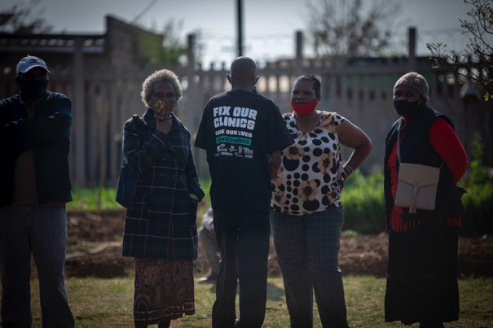
https://ritshidze.org.za/category/tools/

Slide 28
Individual testimonies
+ Individual testimonies are very important—they provide insights and details not provided through facility monitoring.
+ They allow us to raise the voices of community members struggling to access healthcare services and involve them closely in trying to fix the challenges.
+ Working together with community members strengthens our engagement with duty bearers and further efforts to advocate for change.
+ Decision makers can not ignore that the problems highlighted in the data collection are negatively affecting people’s lives.

Slide 29
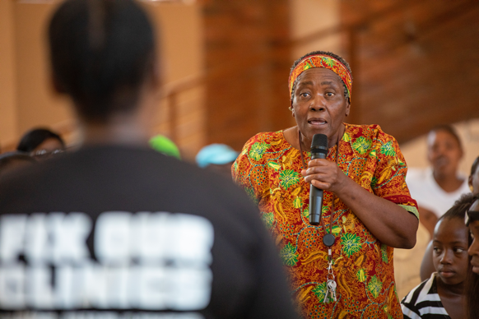
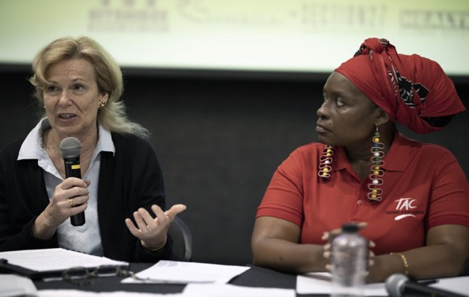
4. Amplify community voices
+ One powerful method to engage duty bearers like PEPFAR is through the use of a community accountability meeting.
+ Bringing people together who have been affected by identified challenges in a community meeting to hold duty bearers accountable is an important advocacy tactic to showcase the findings from community data collection, raise people’s own stories, and put pressure on our targets like PEPFAR to implement our proposed solutions.

Slide 30
5. Engage with PEPFAR
Before the planning meeting – we must outline our demands before the COP22 planning meeting. Hold an community accountability meeting inviting the Office of the Global AIDS Coordinator (OGAC) and the PEPFAR Country team.
At the planning meeting – we must continue to make our demands. Keep track of what PEPFAR promises in the COP22 planning meeting. After the COP22 planning meeting, we must write to the Country Chair and Country Coordinator outlining what promises we heard them make & get it on record.
After the planning meeting – we must ask to see the draft SDS when it is ready. Analyse it. Are our demands and targets included? What is missing? Suggest language they should include in the SDS. Write back to the Country Chair and Coordinator with our consolidated suggestions.
Make it impossible for them to ignore our demands!
Notes:
After the in-country meeting, PEPFAR invites country teams and civil society to Johannesburg to discuss the country priorities together with the OGAC based team. The PEPFAR country team, OGAC technical teams, representatives from global and local civil society organizations, UNAIDS, the Global Fund to Fight AIDS, TB and Malaria, Ministries of Health and the World Health Organization, will all be present. The goal of the meeting is to present the country plan vision for debate and consensus by representatives. In the past, activists have successfully used the meeting to rally and push for changes in the proposed country plan to ensure more ambitious targets and activities are supported.

Slide 31
Make clear asks
Use PEPFAR’s own data
Gather community data
Amplify community voices
Engage with PEPFAR

Slide 32
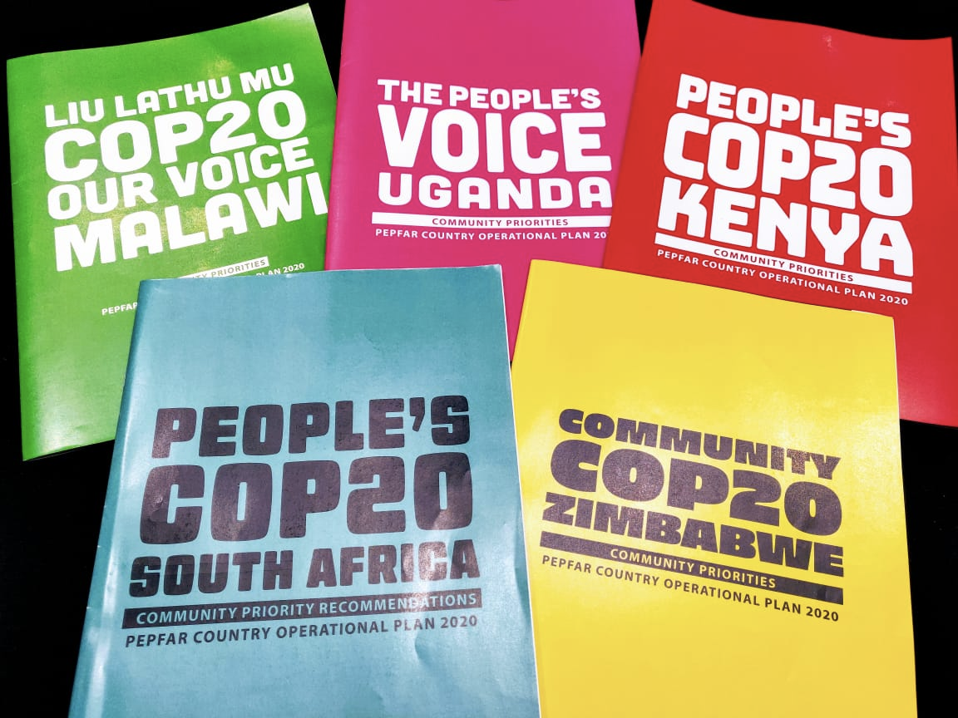
People’s COPs as advocacy tools
Notes:
Every year we translate the findings from our Monitoring efforts to community led solutions

Slide 33
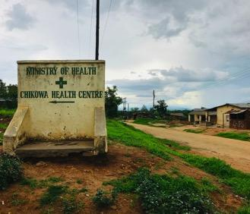
If we are prepared, use the data, gather community evidence, and are bold… We can improve the HIV response for communities in 2022... ☺ Forwards ever!!

Slide 34
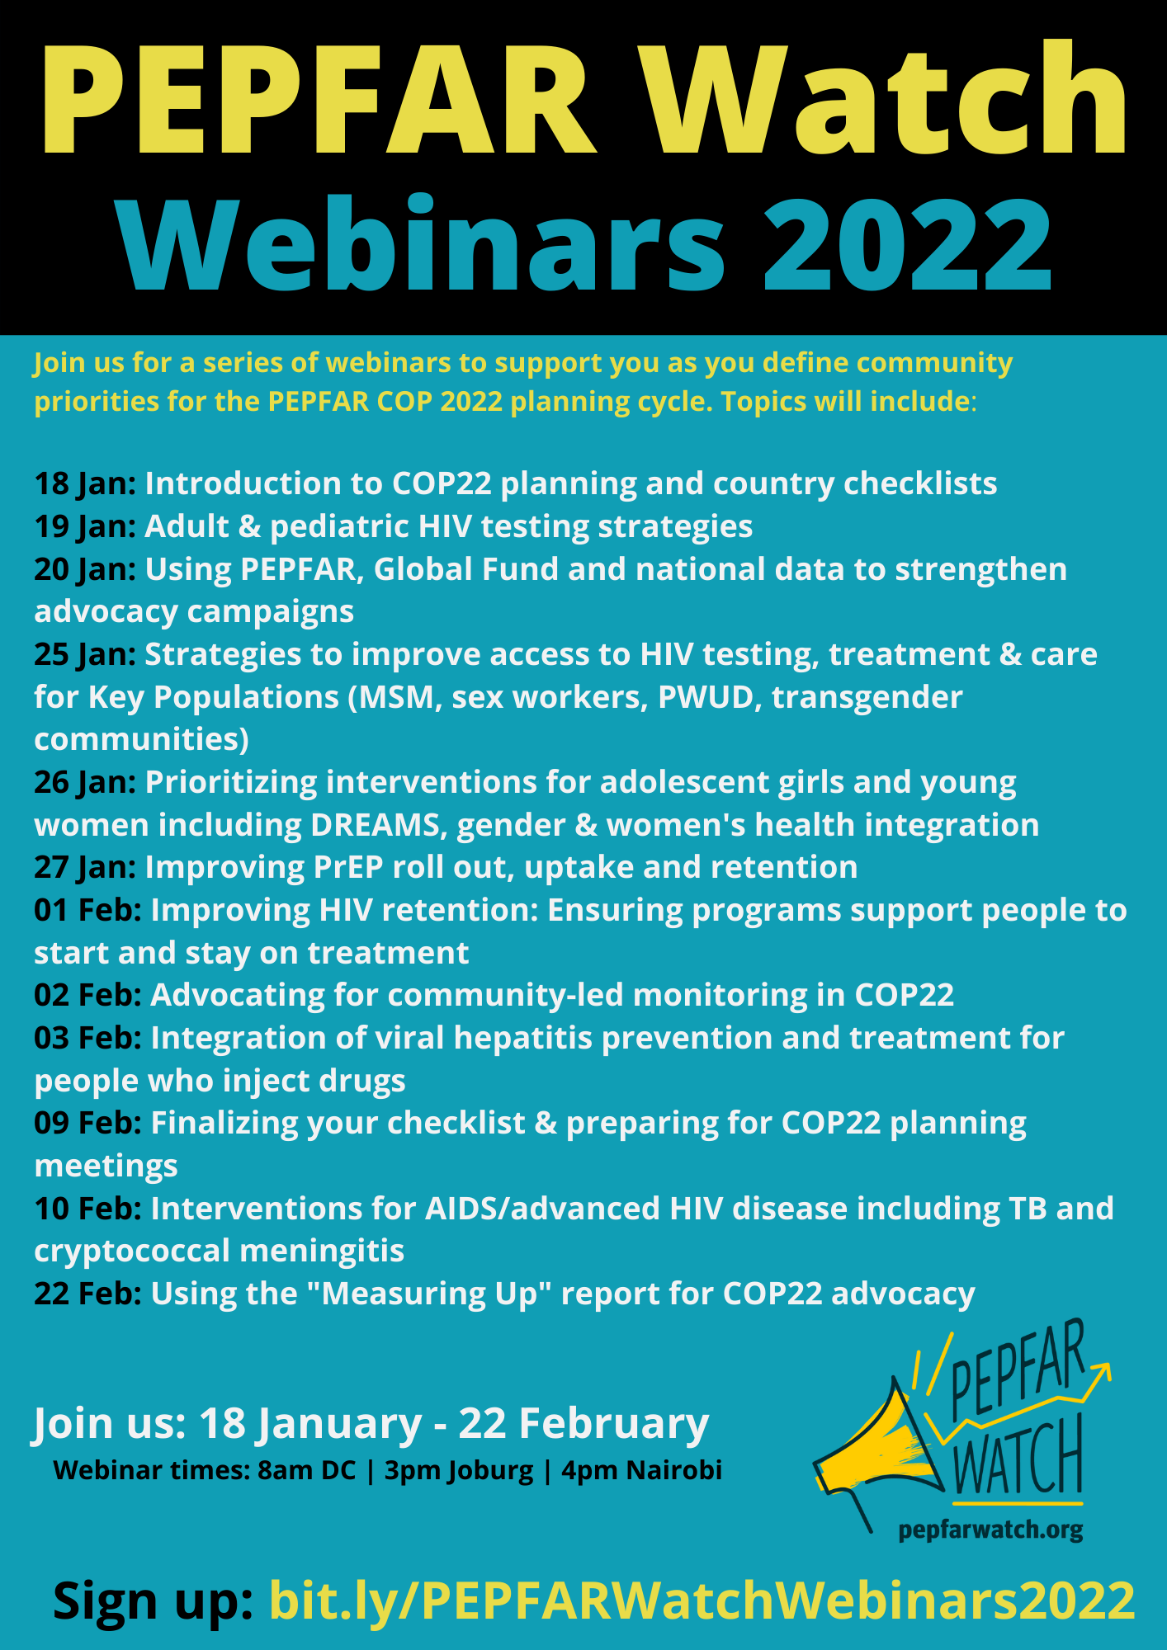
Upcoming COP22 trainings:

Slide 35
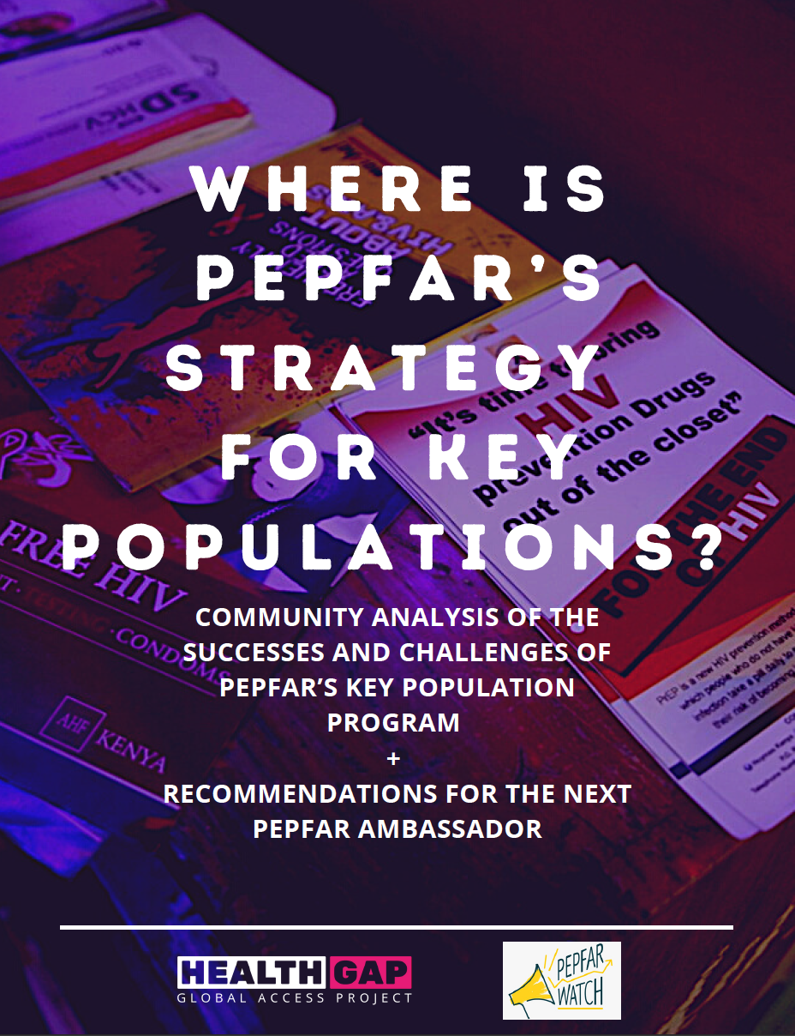
Join us: email info@pepfarwatch.org
thank you!

